Slide 1
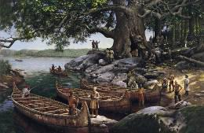
Native Americans of Pennsylvania
Chapter 3, Lesson 2- Part 2
Pgs. 86-91

Slide 2
Possible Questions
Write one question for each of the following words that could possibly be answered in today’s lesson.
Language Nation Artifact
Share your questions with a partner.

Slide 3
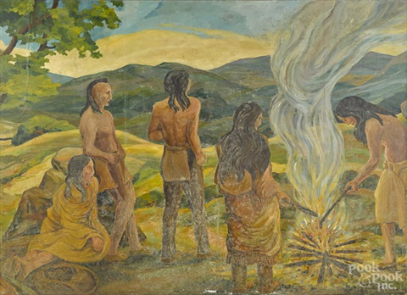
By the year 1600, archeologists believe there were around 15,000 Native Americans living in what is now Pennsylvania among several different tribes.

Slide 4
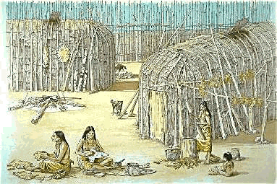
Many of those tribes were divided into small villages called clans.

Slide 5
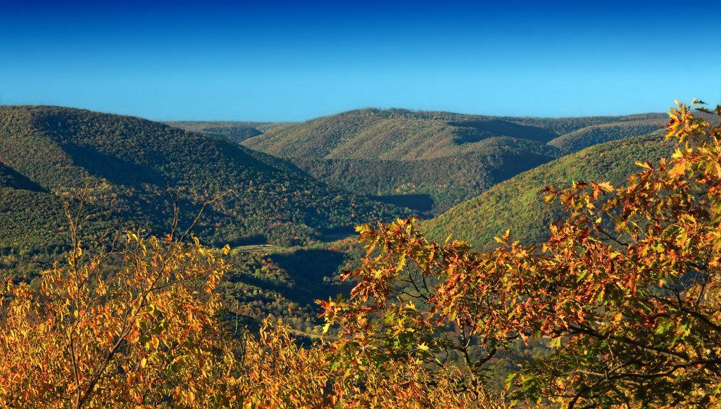
The first known Native American tribe to live in Pennsylvania was the Allegwi tribe. They lived in what is now western Pennsylvania.

Slide 6
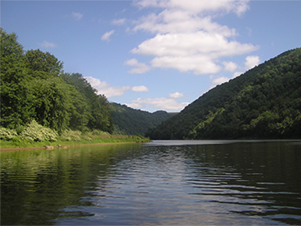
The name “Allegheny” comes from the Native American word “Allegwi”.

Slide 7
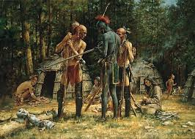
Based on language, most Native American tribes in Pennsylvania could be put into two main groups: the Algonquian and the Iroquois.

Slide 8
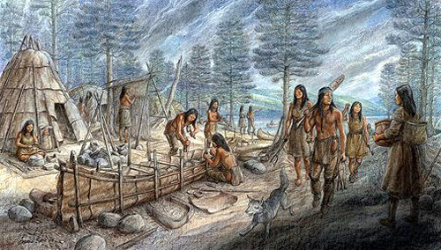
Native American tribes of Pennsylvania that shared the Algonquian language were the Lenni Lenape, the Shawnee, the Nanticoke, and the Conoys.

Slide 9
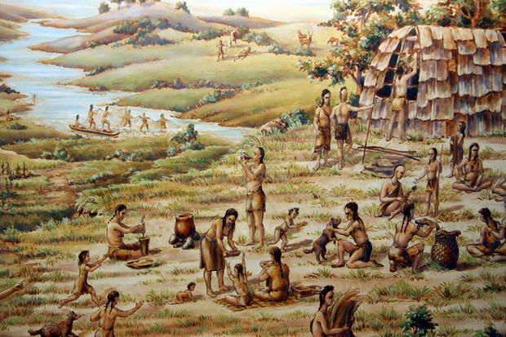
The Lenni Lenape tribe was the largest of the Algonquians. The word Lenape means “people” or “people of the land”.

Slide 10
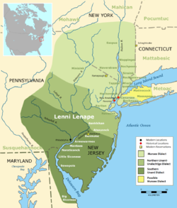
The Lenape lived in the eastern part of Pennsylvania, New York, New Jersey, and Delaware.

Slide 11
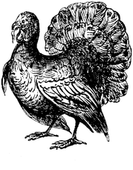
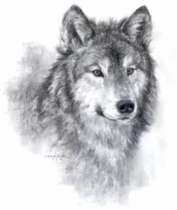
The Lenape tribe was divided into three clans: the Turtle Clan, the Turkey Clan, and the Wolf Clan.

Slide 12
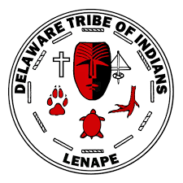
The Lenape tribe became also known as the Delaware tribe.

Slide 13
Think About It!
Why is it helpful to work together as a team? Write your ideas on your paper.
Please share your thoughts with a partner.

Slide 14
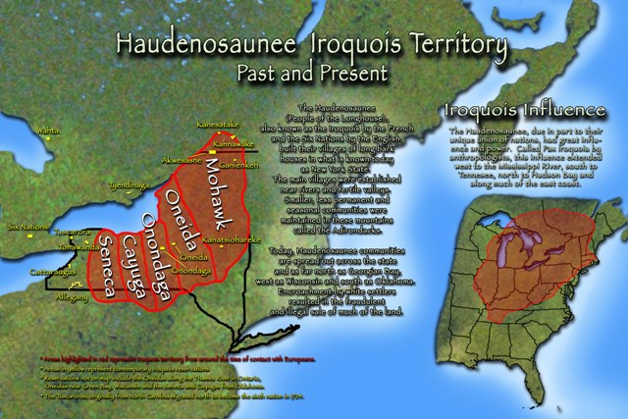
The other main group of Native Americans who lived in Pennsylvania was the Iroquois. They lived in northern Pennsylvania and New York.

Slide 15
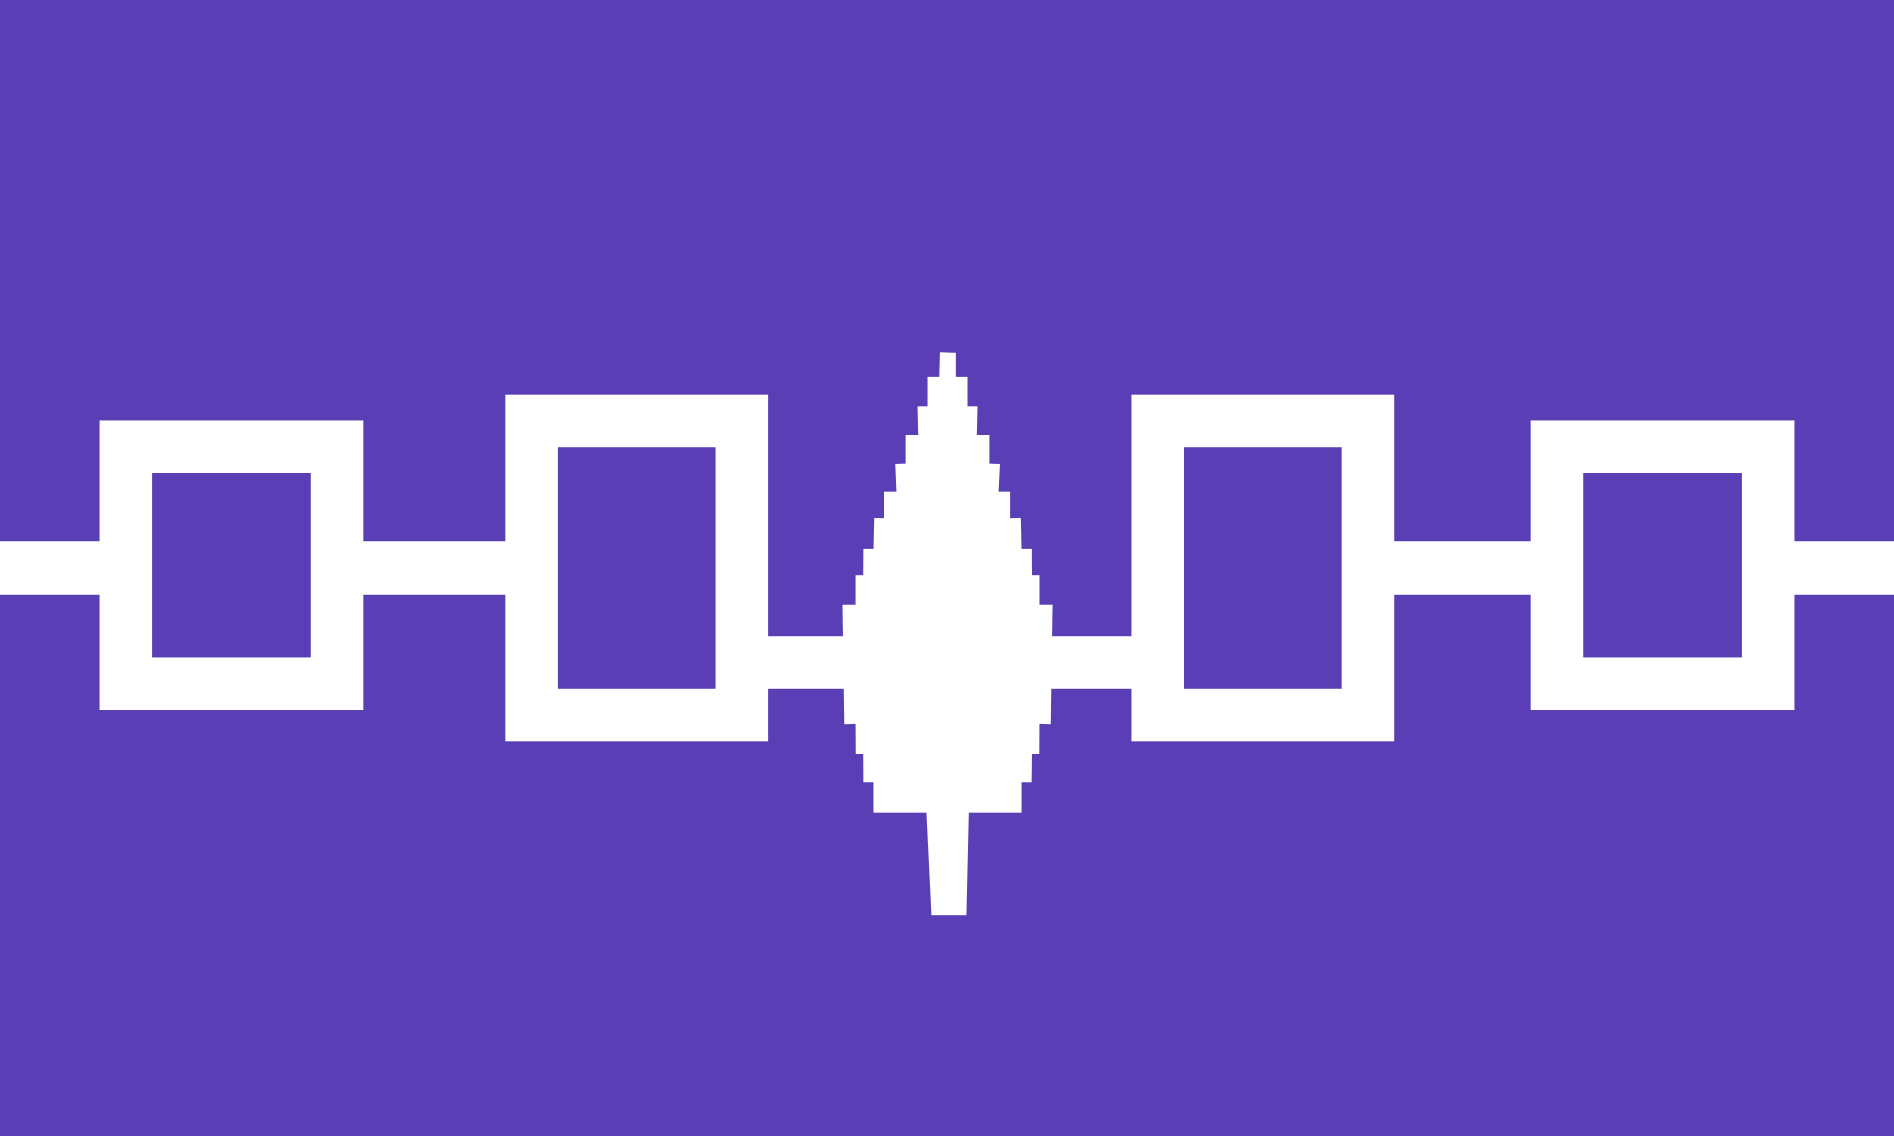
The Iroquois League of Five Nations became one of the most powerful groups of Native Americans in North America.

Slide 16
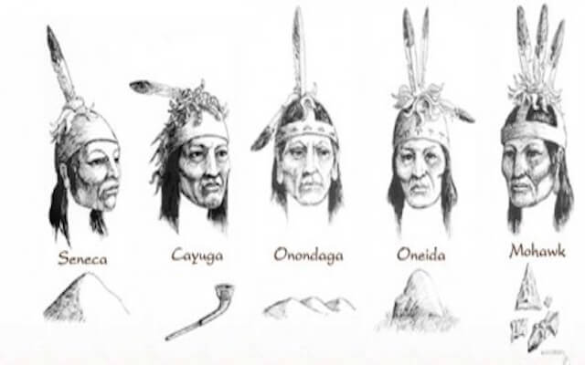
The Iroquois League of Five Nations was a group of five tribes working together for a common good. Those five tribes were the: Seneca, Cayuga, Onondaga, Oneida, and the Mohawk.
Later, the Tuscarora joined the Iroquois Nation.

Slide 17
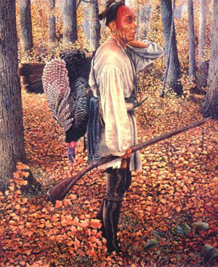
Another tribe of Native Americans who spoke the Iroquois language was the Susquehannock.

Slide 18
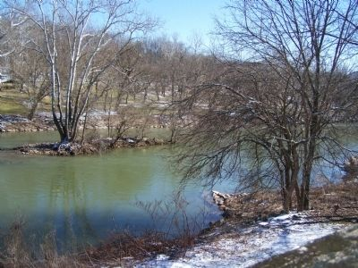
The Susquehannocks lived along the Susquehanna River. The ones who lived in the southern part of Pennsylvania were often called the Conestoga Indians.

Slide 19
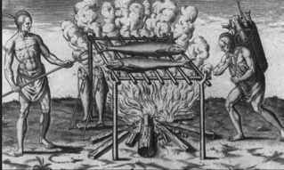
The Erie Native Americans, another group associated with the Iroquois, lived south of Lake Erie. There were many panthers and wild cats in their land so they were nicknamed the Cat Nation.

Slide 20
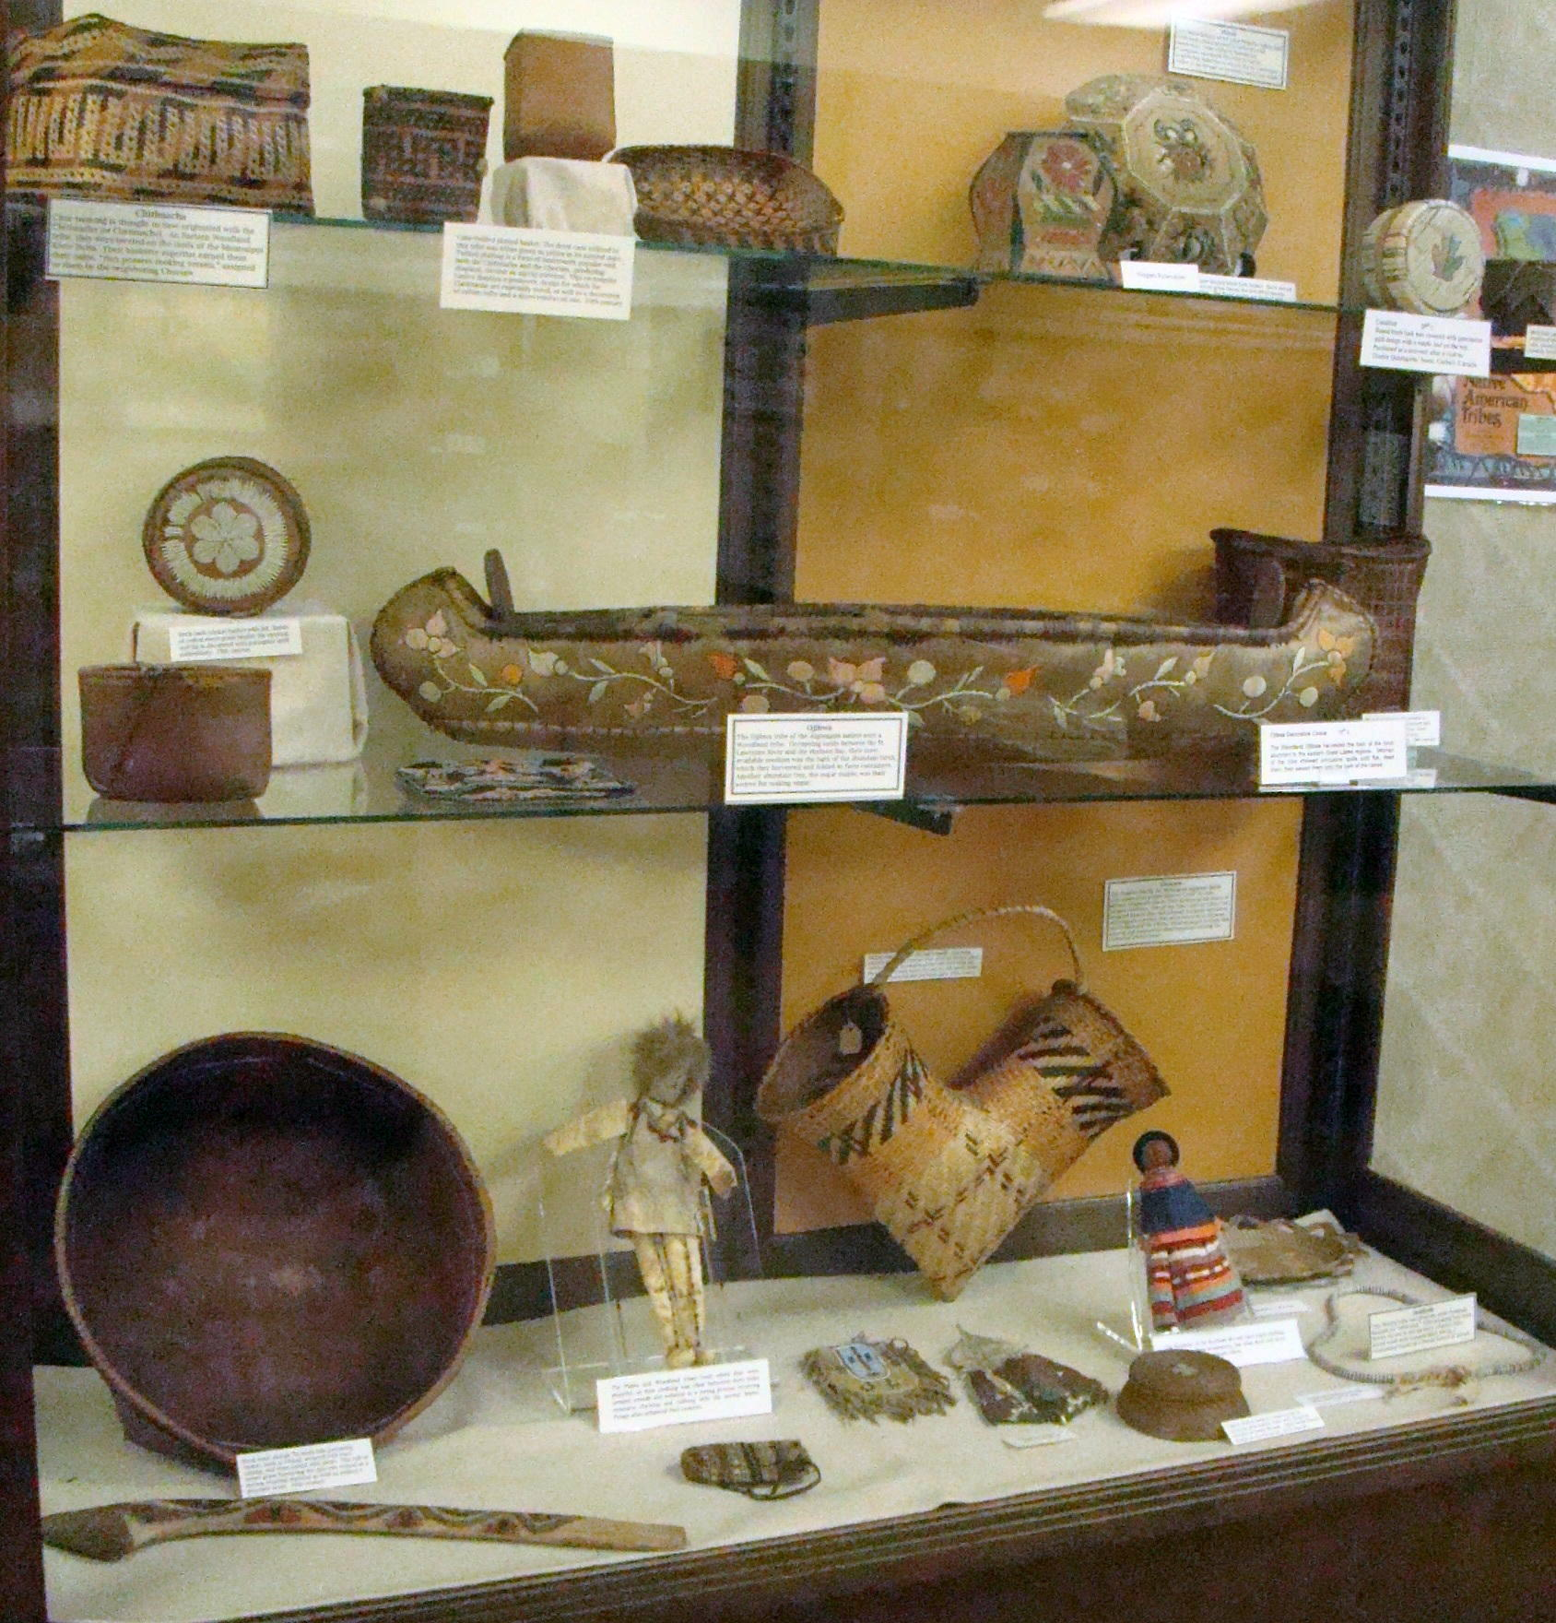
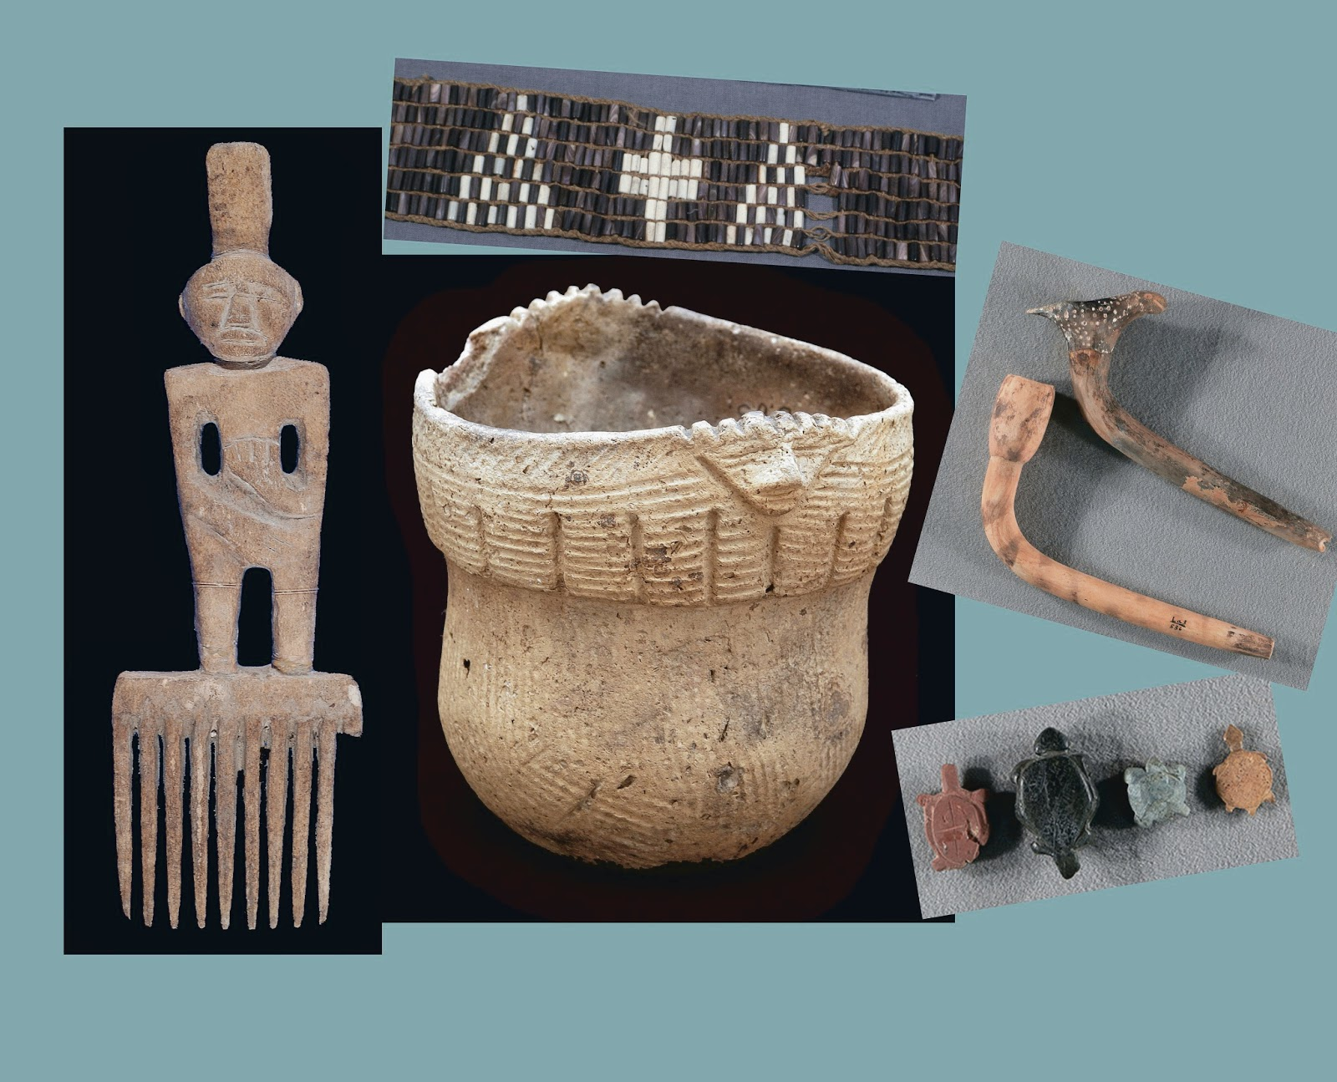
We know about these Native American tribes from stories that have been passed down and artifacts that have been found.

Slide 21
Many of the tribes in Pennsylvania used wampum belts to record their history, make treaties, and to send message.

Slide 22
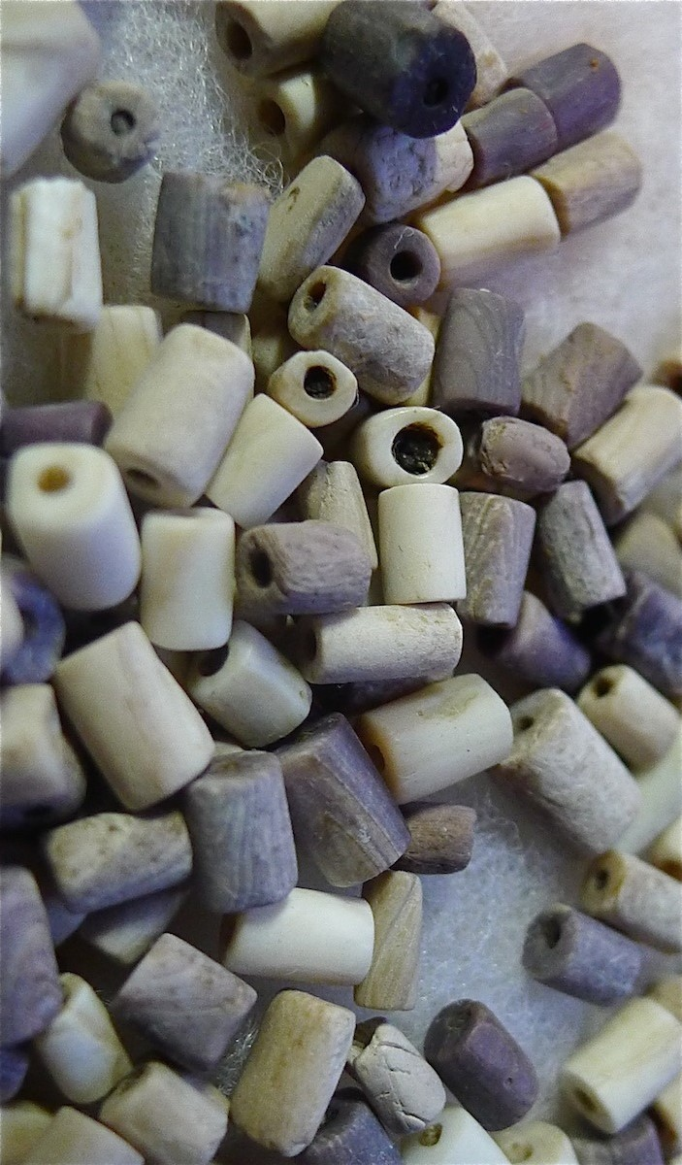
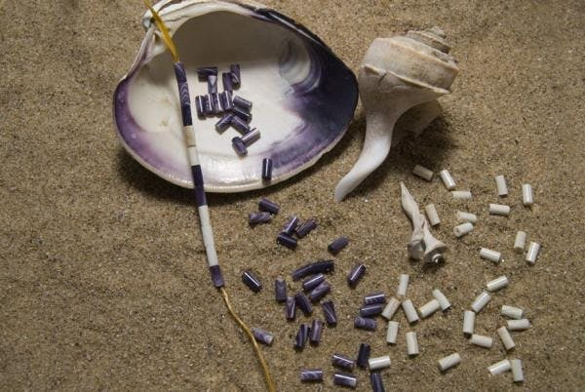
Wampum were beads made out of wood, shells, or quills from porcupines or birds.

Slide 23
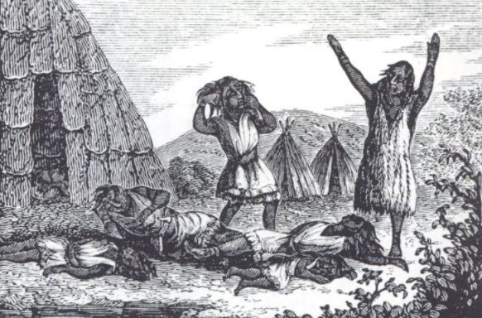
Unfortunately, the Native Americans of Pennsylvania eventually were pushed off their land by Europeans or died from disease, starvation, or war.

